Slide 1
GSA Security container
Order process
Isbel Morrison, FSO/CPSO
Reid Pearson, Security Manager

Slide 2
AGENDA
Background
Fiscal Station Number (FSN)
DoD Activity Address Code (DoDAAC)
GSA Order Form – DD FORM 1348-6
GSA Order Form – Standard FORM 344
GSA Payment Options
GSA Invoicing
Izzie & Reid’s Contact Information
BACKUP SLIDES
Julian Date Conversion Chart
GSA Price Verification
Department of Defense Activity Address Directory (DoDAAD)
Vendor and Customer Self Service (VCSS) – Admin Registration
VCSS – User Registration
VCSS – Invoice Download
GSA-Approved Safe Containers Manufacturer List

Slide 3
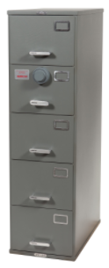
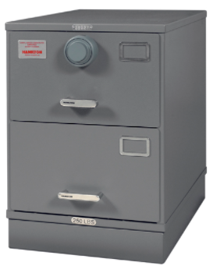
Background
Effective 09/30/2019, GSA Security Container Manufactures will only accept orders from the GSA.
DoD contractors cannot order directly from the GSA portal. A DD Form 1348-6 needs to be submitted.
To complete a DD Form 1348-6, the requestor must enter a valid DoD Activity Address Code (DoDAAC).
To be obtain a DoDAAC, a Government Contracting Officer and/or DoDAAC Coordinator authorization is required.
DoDAAC Coordinator will submit DoDAAC request. The DoDAAC requests requires:
A classified contract with an active task order
DD Form 254/Classified Storage Approved
If DoD contractor is paying for the security containers, a Fiscal Station Number (FSN) is required.
The DoDAAC Coordinator will submit request.
The FSN Request requires the physical mailing address and invoice POC.

Slide 4
FSN Request process
To ensure the government (Defense Finance and Accounting Service) is not billed, a FSN needs to be created
The FSN is needed BEFORE the DoDAAC request is submitted
Requestor shall contact the DoDAAC Coordinator to prepare the FSN request
DoDAAC coordinator will gather the required information and submit the request
The requestor’s mailing address needs to be referenced in the FSN
DO NOT use the Accounts Payable address or a PO Box address
The government will not accept a non-government purchase order
Normally, the address listed in the FSN is where invoices are mailed
Since COVID, invoices are only available through the VCSS portal. See slide 7
The FSN information is also used when registering a DoDAAC in VCSS
DoDAAD/ TAC-3 information is used to populate the organizational data in VCSS

Slide 5
DoDAAC Request process
Contact government Program Office/Acquisition Management Division.
The Acquisition Management Division will complete the DoDACC Request Form and submit it for approval.
Per the GSA instructions for ordering, the contract will require a modification to incorporate FAR Clause, 52.251-1, Government Supply Sources, if not already included. This clause allows the Contracting Officer to issue the contractor an authorization to use Government supply sources; in this case GSA.
An active DD Form 254, cage code and contract/task order is required
A DoDAAC needs to be assigned to the specific line of business referenced in the contract/task order, and should not be shared
The DD Form 254 needs to have Classified Storage Required checked; 11b, 11c and/or 11d is selected
Select the task order with the longest expiration date. While the DoDAAC is active, there is no limit on how many GSA safe orders can be placed.
Once a contract/task order ends, a new DoDAAC request needs submitted under a new contract/task order
To verify the DoDAAC is published, search of it in the DoD Activity Address Directory (DoDAAD)
https://www.transactionservices.dla.mil/eDODAAD/index.asp

Slide 6
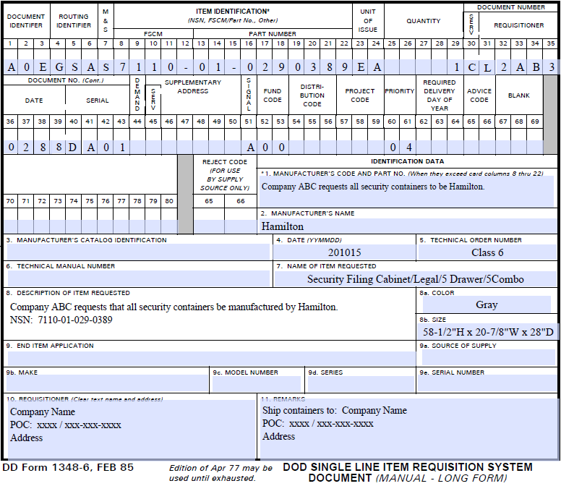
GSA Order Form – DD FORM 1348-6
CELLS | COMMENTS
1-7 | Keep the same
8-22 | Determine safe NSN: https://www.gsa.gov/cdnstatic/Class_6_Filing_Cabinets.pdf Verify current safe cost on GSA Global or GSA Advantage websites (Refer to slide 13) If ordering different types of safes, attach a SF344. See slide 6 for further details.
23-24 | Keep the same
25-29 | Enter the quantity of containers needed
30-35 (Example DoDAAC) | Enter an active DoD Activity Address Code (DoDAAC). GSA will not ship an order to a DoD Contractor unless an active DoDAAC is verified. GSA will verify the DoDAAC through the DoD Activity Address Directory (DoDAAD) https://www.dla.mil/HQ/InformationOperations/DLMS/DLMSPrograms/DoDAAD/
36-39 | Enter date in Julian date format. (Refer to slide 12)
40-43 | This unique four-character code (presumably sequential, and numeric or alphanumeric ) is assigned by requestor for their own control purposes. It must not be duplicated on any one day.
51, 52-53, 60-61 | Keep the same. Cells 60-61 identifies priority (01, the highest, to 15, the lowest)
Identification Data Field 1 and 8 | If you want a specific container manufacture, specify it here. If you do not, GSA will make the selection for you.
Field 5, 7, 8a, 8b | Fill in this information if available. This information is found on the GSA Global Supply Portal or the GSA Security Container Catalog by searching by the NSN.
Field 10 | Enter requestor name and address
Field 11 | If requestor wants the containers to be shipped to a different location within the LOB, enter the address and POC in field 11. Otherwise the items will be shipped to the address listed in field 10.
Completed Form | Email DD Form 1348-6 to rpc@gsa.gov

Slide 7
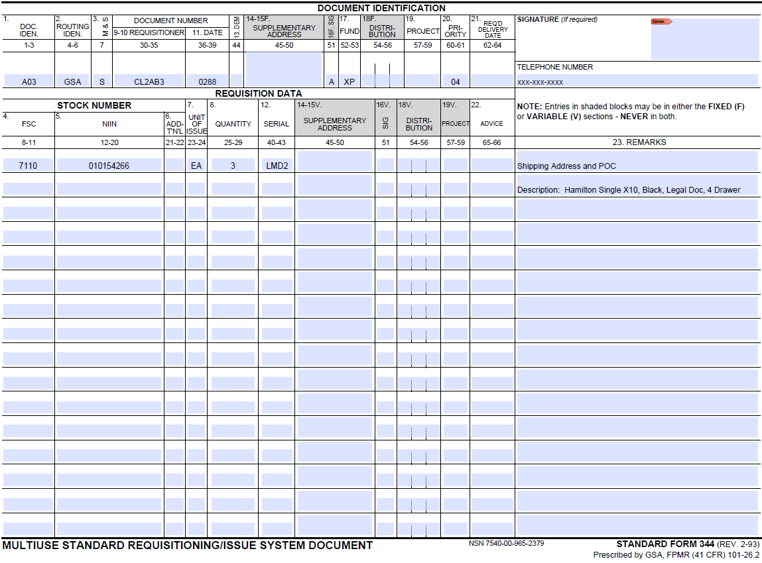
GSA Order Form – Standard FORM 344
CELLS | COMMENTS
 | If ordering different types of containers in the same request, attach a SF344 to the DoD Form 1348-6. https://www.gsa.gov/cdnstatic/SF_344_fillable.pdf Note: Dashed numbers below field represent the corresponding cells in the DoD Form 1348-6.
DOC ID 1-3 | Keep the same
DOC ID 9-10 (Example DoDAAC) | Enter DoDAAC listed on 1348-6
DOC ID 11 | Enter Julian date
DOC ID 16f, 17, 20 | Keep the same Cells 60-61 identifies priority (01, the highest, to 15, the lowest)
Signature | Enter Adobe digital signature
Phone Number | Enter phone number of person signing
REQ DATA 4, 5 | Enter NSN; 8-11 first four digits and 12-20 the remaining digits Determine safe NSN: https://www.gsa.gov/cdnstatic/Class_6_Filing_Cabinets.pdf Verify current safe cost on GSA Global or GSA Advantage websites (Refer to slide 13)
REQ DATA 7 | Keep the same
REQ DATA 8 | Enter the quantity of safes
REQ DATA 12 | This unique four-character code (presumably sequential, and numeric or alphanumeric ) is assigned by requestor for their own control purposes. Each item requires a different code, and it must not be duplicated on any one day.
23. Remarks | Enter Shipping Address and delivery POC
23. Remarks (Below Shipping Address) | Enter safe description. If you want a specific container manufacture, specify it here. If you do not, GSA will make the selection for you.
Completed Form | Attach with DD Form 1348-6 and Email to rpc@gsa.gov

Slide 8
GSA payment Options
The GSA WILL NOT accept a private company’s purchase order
There are only two ways to reimburse the GSA for safe orders:
Check Request
Pay.gov (Credit Card)
Pay.gov limit per transaction is $24,999.99
You cannot slit the payment for invoices over $24,999.99
All invoices over $25,000 require a check request
Each safe order requires two payments:
Material (Safes)
S&H (Billed After Material Is Shipped)
Pay.Gov Instruction

Slide 9
GSA Invoices - VCSS
Since COVID, the GSA no longer mails paper invoices
GSA invoices can only be downloaded through the Vendor & Self Service (VCSS) portal
The first person to register a DoDAAC is the Account Admin
The Account Admin role normally requires a government employee
The VCSS leadership granted an exception for DoD contractors who have a DoDAAC setup for GSA Security Container Orders.
All persons who require a user account for a DoDAAC must be approved by the Account Admin
VCSS
Brochure
VCSS
User Account Request
VCSS
Admin Change Request

Slide 10
references
GSA Security Container Homepage: https://www.gsa.gov/buying-selling/purchasing-programs/requisition-programs/gsa-global-supply/national-stock-numbers/security-containers/ordering-procedures-for-security-containers
GSA Security Container Catalog: https://cmls.gsa.gov/servlet/servlet.FileDownload?retURL=%2Fapex%2FCMLSPubCategory%3FsearchKey%3DCA-0025721&file=00Pt000000Jt4L2EAJ
Types of GSA Containers: https://www.gsa.gov/buying-selling/purchasing-programs/requisition-programs/gsa-global-supply/national-stock-numbers/security-containers/types-of-security-containers
End of GSA Exemption Process: https://www.gsa.gov/cdnstatic/General_Supplies__Services/End_of_Exemption_Process_Letter_508.pdf
DD Form 1348-6: https://www.gsa.gov/cdnstatic/DD1348-6_FillableForm.pdf
Submit DD Form 1348-6 To: rpc@gsa.gov
Each 1346-6 can only list one safe at a time
Contact rpc@gsa.gov with form questions
Standard Form 344 https://www.gsa.gov/cdnstatic/SF_344_fillable.pdf
For orders with more than one type of safe, attach SF344 to 1346-6 form submission
Contact rpc@gsa.gov with form questions
GSA Security Container POC: Marty Cieszlak martin.cieszlak@gsa.gov
Department Email securitycontainers@gsa.gov
VCSS Registration: vcss.registration@gsa.gov
Hamilton Class 6 Safes: https://hamiltonproductsgroup.com/products/class-6/
Department of Defense Activity Address Directory (DoDAAD): https://www.dla.mil/HQ/InformationOperations/DLMS/DLMSPrograms/DoDAAD/
GSA Global: https://www.gsaglobalsupply.gsa.gov/advantage/ws/main/start_page?store=FSS
GSA Advantage: https://www.gsaadvantage.gov/advantage/ws/main/start_page

Slide 11
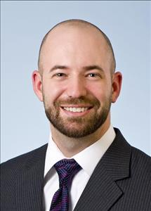
Contact information
Isbel “Izzie” Morrison, FSO/CPSO Lockheed Martin Missiles & Fire Control
5600 Sand Lake Road, Orlando, FL 32819
Desk: 689-206-7132 Mobile: 407-242-1930 Email: Isbel.M.Morrison@lmco.com
Reid Pearson, Security Manager Lockheed Martin Missiles & Fire Control
5600 Sand Lake Road, Orlando, FL 32819
Desk: 407-356-9797 Mobile: 214-236-5731 Email: Reid.Pearson@lmco.com

Slide 13
BACKUP SLIDES

Slide 14
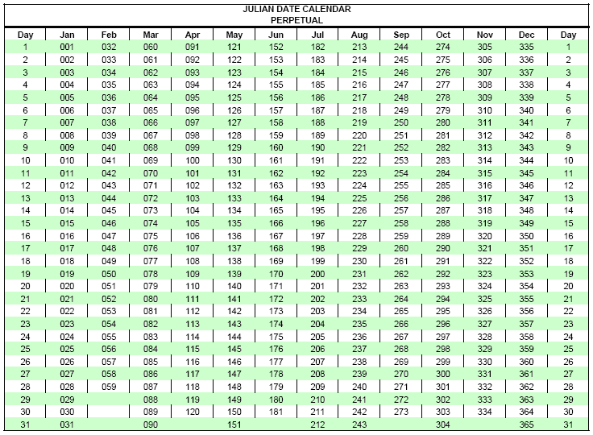
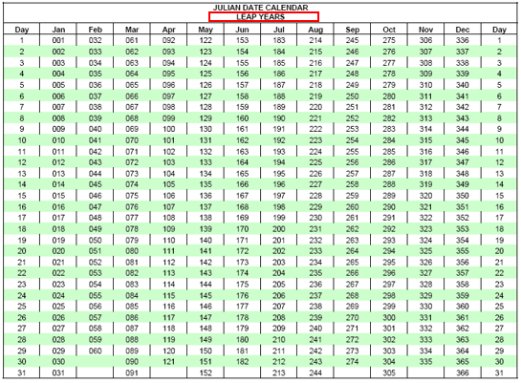
Julian Date Conversion Chart
A Julian date is used to refer to a date format that is a combination of the current year and the number of days since the beginning of the year. For example, January 1, 2024 is represented as 2024001 and December 31, 2024 is represented as 2024365.

Slide 15
GSA Price verification
The current prices for GSA safes can be found on the GSA Advantage and GSA Global Supply.
Copy and paste the NSN number into one of the GSA websites.
Both websites have access to the same safe price info.
Provides the worst-case scenario pricing across multiple manufacturers.
https://www.gsaadvantage.gov/advantage/ws/main/start_page
https://www.gsaglobalsupply.gsa.gov/advantage/ws/main/start_page?store=FSS
A listing of all GSA Class 6 Security Containers can be found in the GSA catalog.
The NSN number remains constant throughout the different publications and GSA websites.
What is the difference between GSA Global Supply's website and GSA Advantage?
Both sites display more than 400,000 items available from GSA Global Supply, with identical pricing and terms (They even accept the same user name and password).
GSA Advantage also displays more than 20 million products and services available from more than 18,000 Multiple Award Schedule (MSA) contractors.

Slide 16
Department of Defense Activity Address Directory
(dodaad)

Slide 17
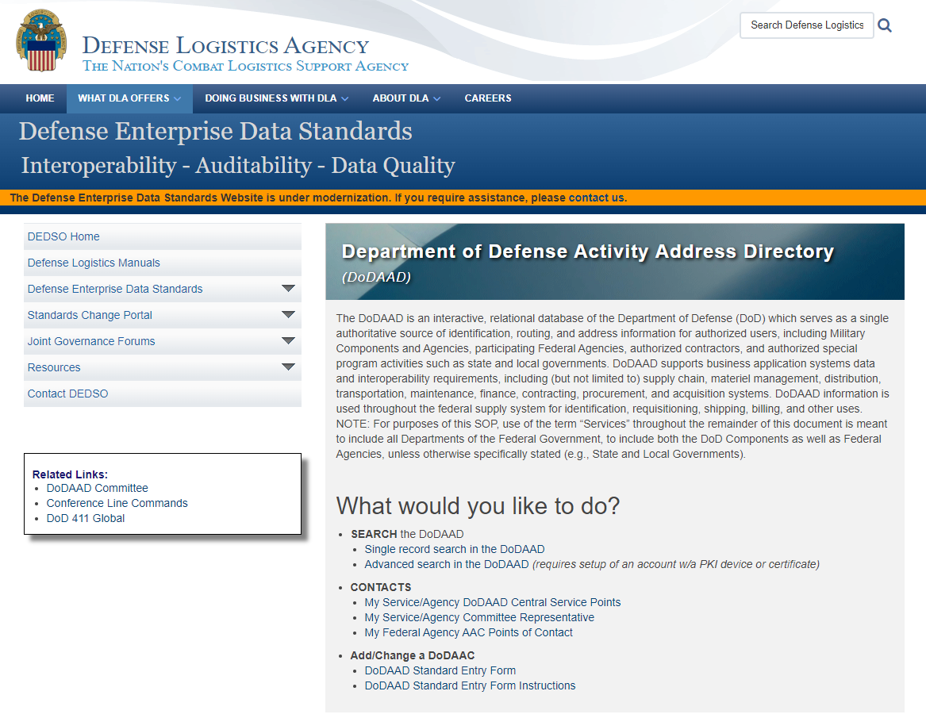
DoDAAD
https://www.dla.mil/HQ/InformationOperations/DLMS/DLMSPrograms/DoDAAD/
To determine if a DoDAAC is active or expired, conduct a search in the DoDAAD
Select Single Record Search

Slide 18
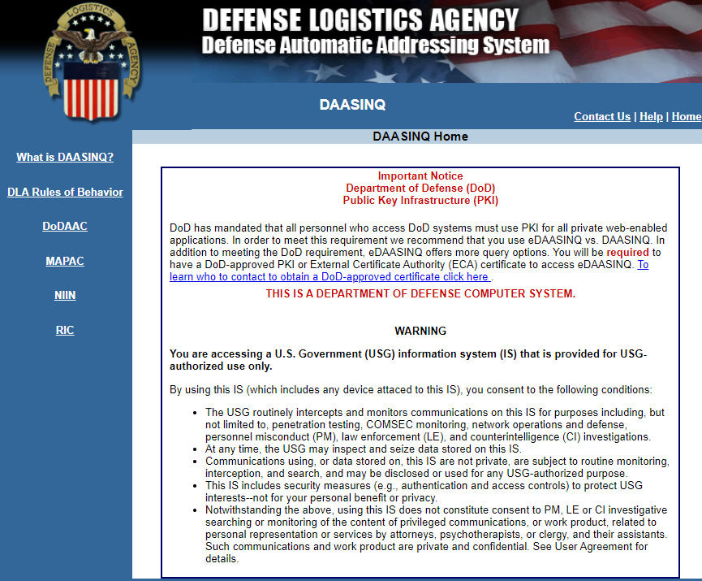
DoDAAD
Select DoDAAC

Slide 19
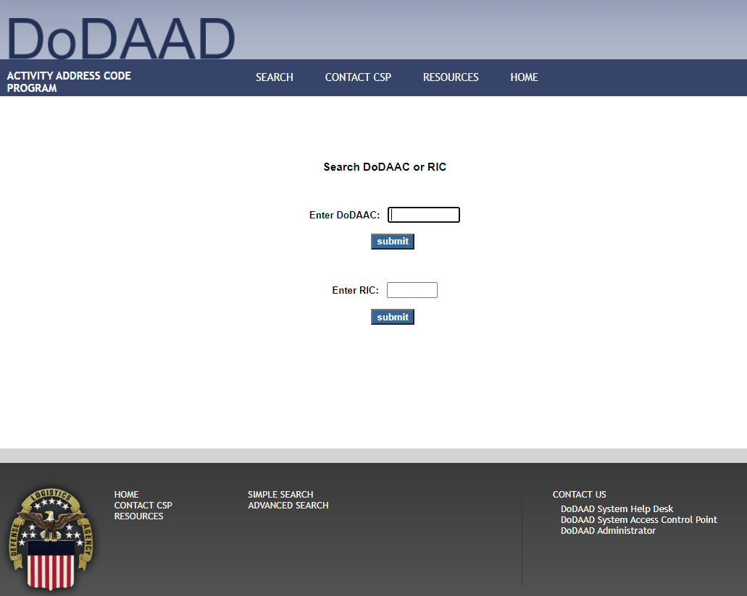
DoDAAD
Enter DoDAAC and click submit

Slide 20
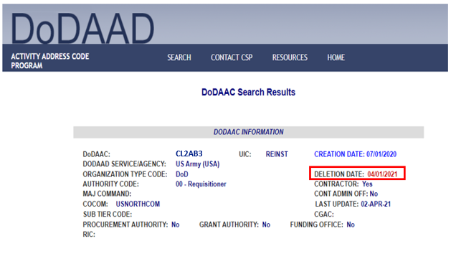
DoDAAD
If the Deletion Date is past the current date, the DoDAAC has expired and cannot be used.
If the DoDAAC is expired contact the DoDAAC Coordinator listed at the CSP Information section, and ask if the DoDAAC has been extended. If not, a new DoDAAC will be needed.
TAC 1 and TAC 2 are the performance locations listed in the DD Form 254.
TAC 3 is the FSN data for billing

Slide 21
Vendor and customer self service (VCSS)
Admin Registration

Slide 22
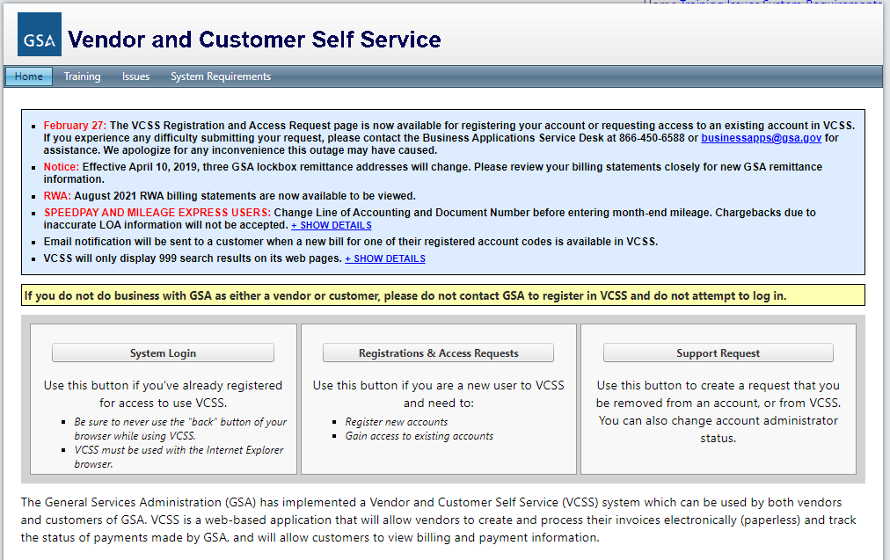
VCSS ADMIN Registration
https://vcss.ocfo.gsa.gov/Default.aspx
As stated on slide 7, The first person to register a DoDAAC in VCSS is the Account Admin
NOTE: Normally a government employee is to be the VCSS Admin
The GSA granted an exemption for DoD Contractors ordering safes
Select Registration and Access request

Slide 23
VCSS ADMIN Registration
Select Customer Registrations and Access Requests

Slide 24
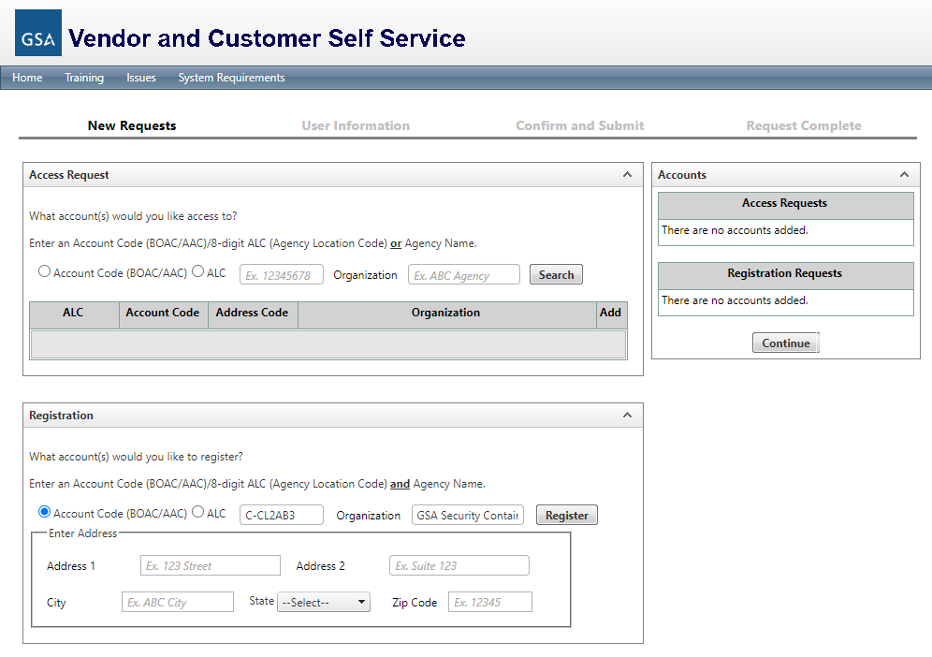
VCSS Admin Registration
In the Registration section, enter the following information:
Account Code: Enter DoDAAC
Organization: “GSA Security Container Customer”
Address: Company Mailing Address
Click Register
Note: “GSA Security Container Customer” is only used by the VCSS to identify a non-government employee. Once the registration process is completed, the company name listed in the DoDAAC/FSN will be used in the Organization field.
The FSN information is listed in the TAC-3/Billing field in the DoDAAD

Slide 25
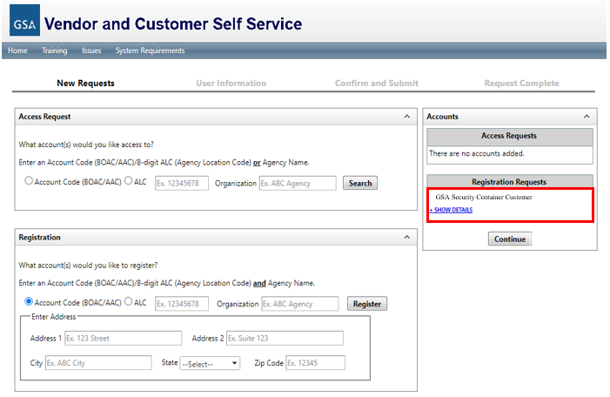
VCSS Admin Registration
The information is moved to the Registration Request window.
Click Continue

Slide 26
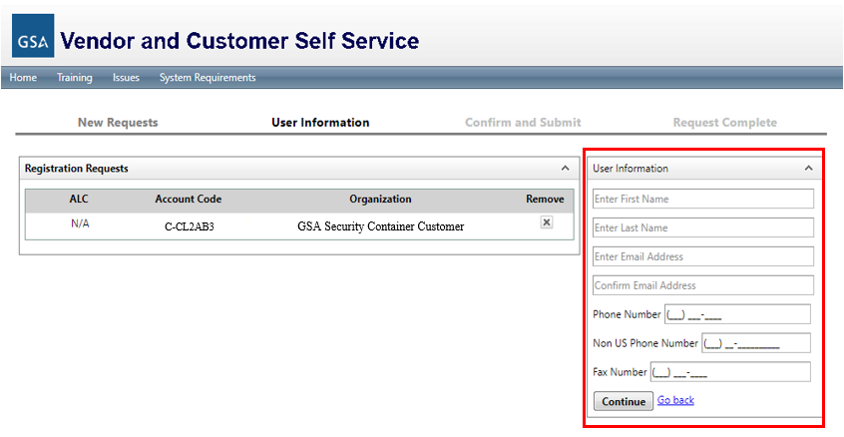
VCSS Admin Registration
Complete the user request information.
Complete all the User Information Fields. Note, only one phone number is required, and FAX is optional.
Click Continue

Slide 27
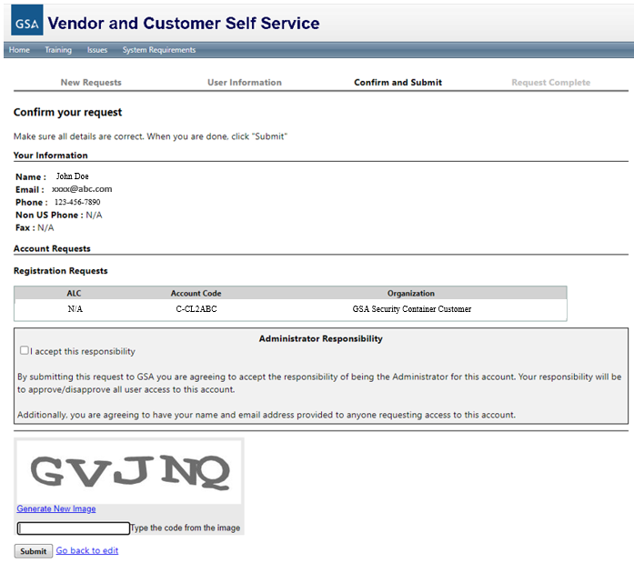
VCSS Admin Registration
Review the user information for accuracy
Check the box for “I accept this responsibility”
Enter the unique number sequence displayed and click submit.
Click Submit

Slide 28
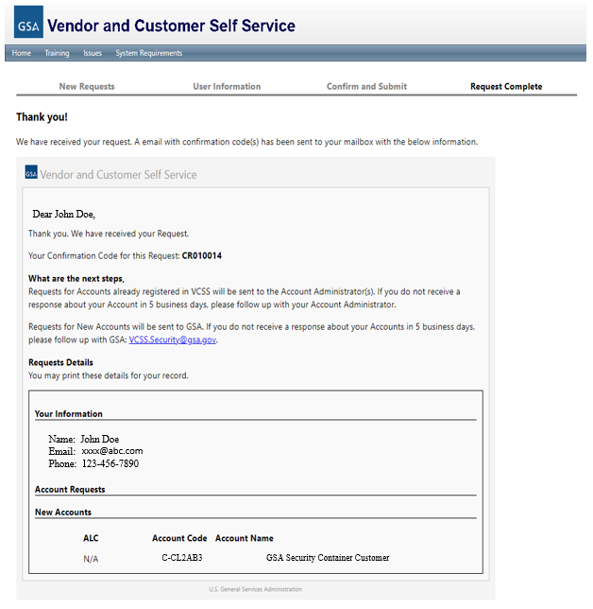
VCSS Admin Registration
The Account Admin will receive a confirmation Email
Once approved the VCSS team will Email the Account Admin login instructions

Slide 29
Vendor and customer self service (VCSS)
user Registration

Slide 30
VCSS User Registration
https://vcss.ocfo.gsa.gov/Default.aspx
Select Registration and Access request

Slide 31
VCSS ADMIN Registration
Select Customer Registrations and Access Requests

Slide 32
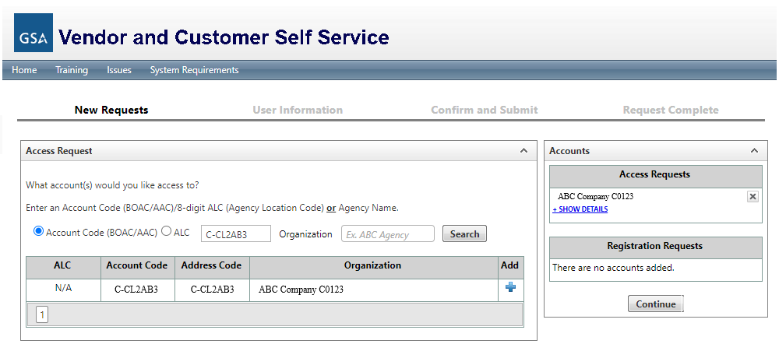
VCSS User Registration
In the Account Code Field under Access Request, enter the DoDAAC and click search
In the search results field, click the plus symbol to the right of the Organization and it will be added to the Access Request field
Click Continue

Slide 33
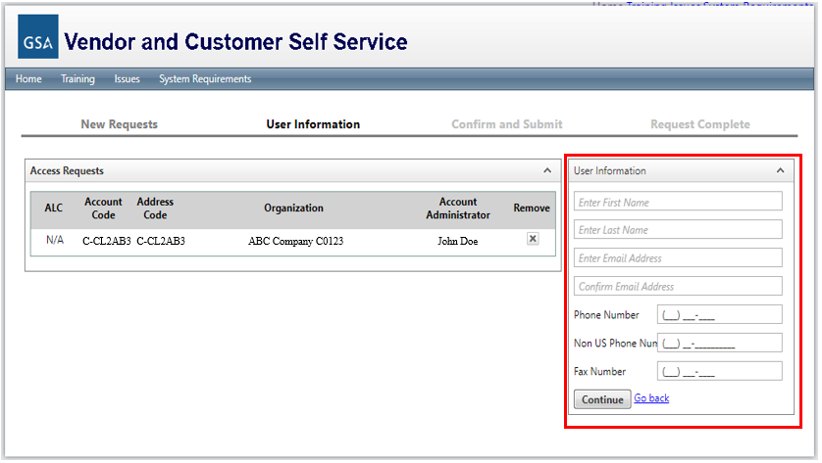
VCSS User Registration
The VCSS Admin info will be displayed for the selected DoDAAC
Complete all the User Information Fields. Note, only one phone number is required, and FAX is optional.
Click Continue

Slide 34
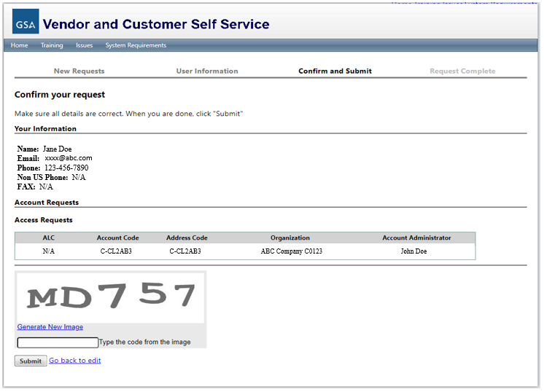
VCSS User Registration
Review the user information for accuracy
Check the box for “I accept this responsibility”
Enter the unique number sequence displayed and click submit.
Click Submit

Slide 35
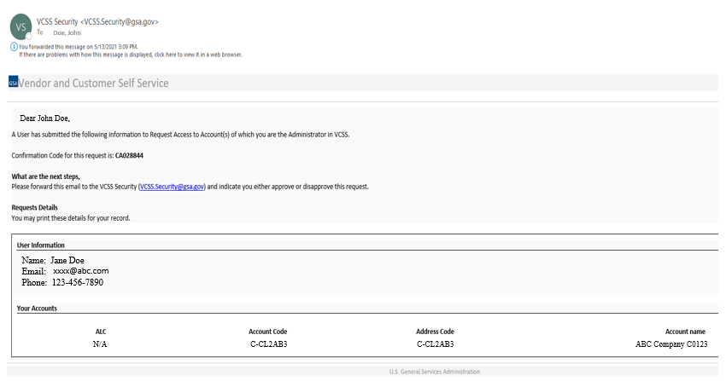
VCSS User Registration
Account Admin will receive an automated Email for VCSS.
The Account Admin needs to forward the Email back to VCSS Security approving the user request.
Once the approval request has been received and processed, VCSS Security will Email the user login instructions.

Slide 36
Vendor and customer self service (VCSS)
Invoice Download

Slide 37
VCSS Invoice Download
The VCSS Admin will receive an automated Email when a new invoice is posted to a DoDAAC.
To obtain a copy of the invoice, someone will need to log into VCSS and download it.
Paper invoices are no longer mailed to the billing address.

Slide 38
VCSS Invoice Download
https://vcss.ocfo.gsa.gov/Default.aspx
Select System Login

Slide 39
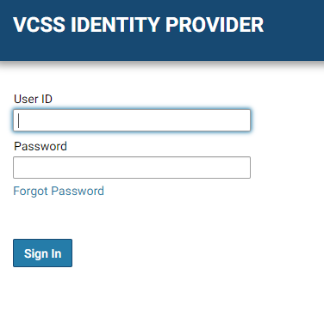
VCSS Invoice Download
Top right corner, select Guest
Select System Sign In
Enter User ID and Password and select Sign In

Slide 40
VCSS Invoice Download
Left toolbar, select Statement and then View and Print Statements

Slide 41
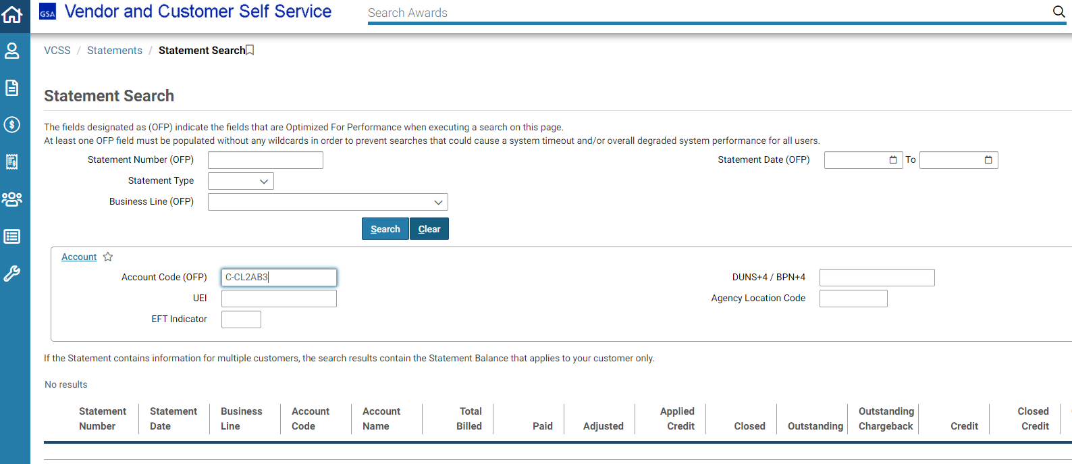
VCSS Invoice Download
Enter DoDAAC in the Account Code Field
Note: Always enter a “C” and a dash before the DoDAAC

Slide 42
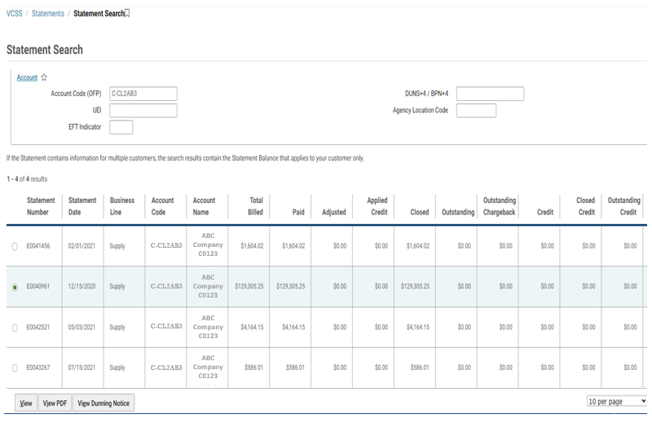
VCSS Invoice Download
Click the circle next to the invoice to download
Select view PDF
Save a copy to your desktop

Slide 43
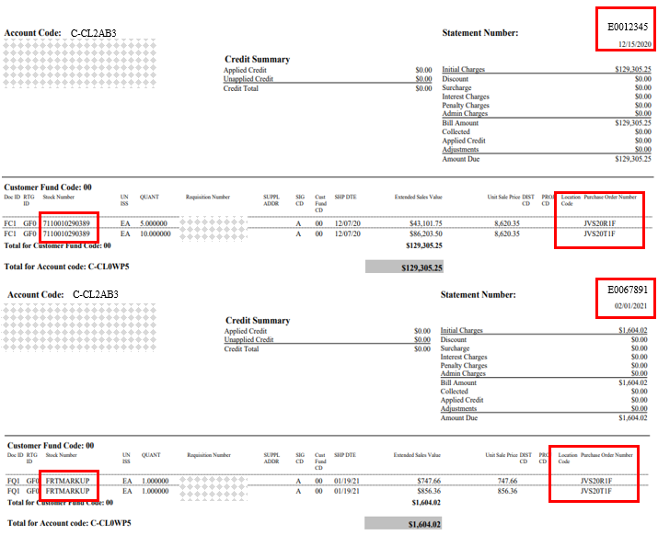
VCSS Invoice Download
Invoice E0012345 is the material order. This is identified under the Stock Number column; the product NSN number is listed.
Invoice E0067891 is the S&H charges. This is identified under the Stock Number column; FRTMARKUP is listed.
Even though the material and S&H invoice numbers are different, the GSA purchase order numbers are the same.

Slide 44
VCSS Invoice Download
The View and Print Statements page can also be used to determine if the GSA has received payment (Closed) or if the payment is still outstanding.

Slide 45
Current list of gsa-approved safe container manufacturers

Slide 46
Gsa-approved safe manufactures
Hamilton
Will-Burt
American Made Safe & Security, LLC
Alpha Safe and Vault Inc.
KL Security Enterprises

